Slide 1
A Planned Future for Mason
A New Journey: Why a comprehensive Plan is Needed In Mason

Slide 2
What is a comprehensive Plan?
Policy Document For guidance on growth and management
an extremely broad scope
includes the entire municipality
Provides multiple goals and policies to be enacted over time

Slide 3
Why do we need a comp plan
An opportunity to see the big picture
used as a basis for local decision making
Gives developers an idea on projects that will be approved (Blue Oval City)
Increased access to funding and capital resources
Creates an informed and unified community

Slide 4
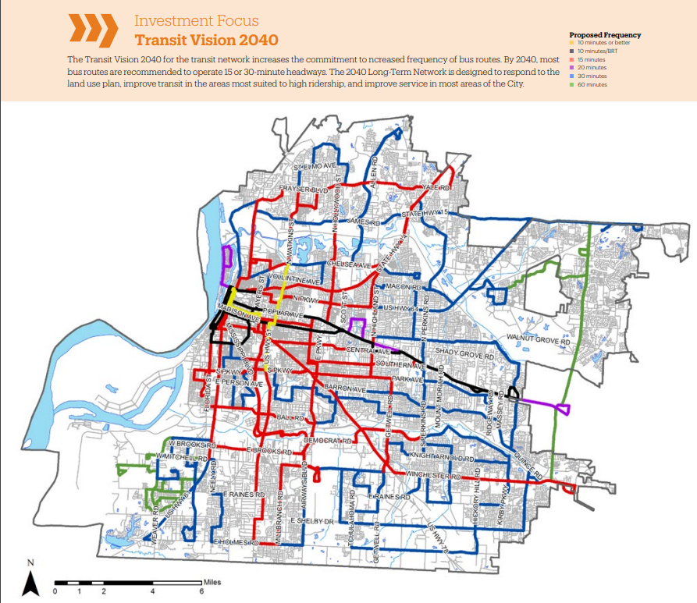
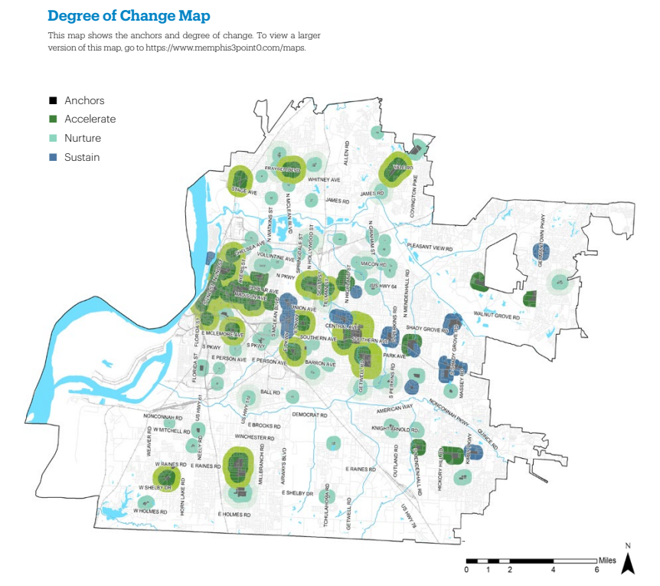
Maps, maps, maps!

Slide 5
What is in a comp plan? Themes
Common Specialties
Housing
Land use
Transportation
Community facilities
Economic development
Education
Natural resources
Historic preservation
Climate change
Intergovernmental cooperation

Slide 6
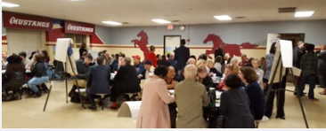
Public Engagement

Slide 7
Plan implementation
Specific public and private action steps
Framework for public investments
Time frames and estimated costs
Gives developers/investors clear next steps
Community support determine priority of implementation

Slide 8
Swot analysis

Slide 9
Thank you!
Questions?

